Slide 1

DS 5110 Final Project
(Group 4)
Ryan Healy, Nicholas Miller, Charles Lotane
Project Github

Slide 2
Project Overview and Approach
Our project aimed to build a scalable AI infrastructure tailored to astronomy analysis
Objective
Actions Taken
Outcome
Step Functions
Use AWS Step Functions to build scalable workflow for AI inference
Designed state machine
Configured IAM roles for access to S3 buckets
Used JSON payloads to pass parameters
Executed a scalable workflow capable of processing across configurations
1
Rendezvous Server
Enable communication between Lambda functions for parallel processing
Deployed Rendezvous server
Integrated FMI library
Validated server’s ability to coordinate across Lambda functions
Enabled synchronized execution of inference tasks
2
AI for Astronomy Inference
Run inference on preprocessed astronomy datasets to predict redshift values
Used inference.py to work with distributed processing
Configured devices for compatability with local environments
Validated predictions
Achieved accurate redshift predictions with similar predicted and true values
3
CosmicAI with Lambda FMI
Orchestrate AI inference using Lambda functions with FMI
Deployed cosmicai with payload configurations
Captured performance metrics with CloudWatch logs and JSON outputs
Enabled scalable, parallel inference across multiple Lambda instances
4
Testing at Scale
Assess performance under varying configurations and data sizes
Experimented with multiple batch sizes
Benchmarked execution time, cost, and throughput access
Validated parallel execution
Confirmed infrastructure can handle increasing workloads while maintaining efficiency
5

Slide 3
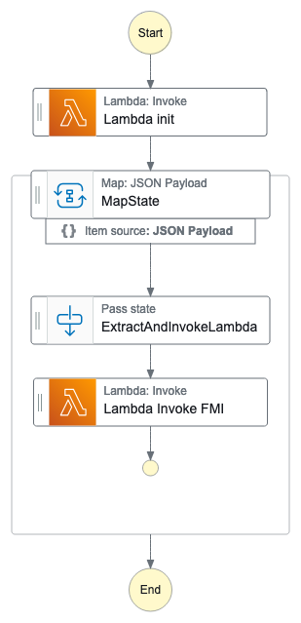
Step Function Workflow Orchestration
Step Functions
Rendezvous Server
AI for Astronomy
CosmicAI with FMI
Testing at Scale
1. Lambda Init
Prepare runtime environment and load configurations (e.g. world size, batch size)
2. Map State
Assign tasks to multiple Lambda functions, iterating over a JSON payload
3. Extract and Invoke
Ensure that each Lambda function receives necessary allocated data and carries out inference
4. Lambda Invoke FMI
Invoke FMI interface to synchronize distributed tasks
5. End State
Ensure all results are logged and stored in S3

Slide 4
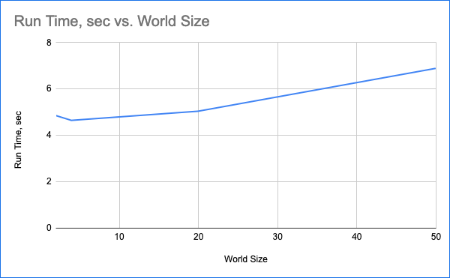
Step Function Midterm Results
Step Functions
Rendezvous Server
AI for Astronomy
CosmicAI with FMI
Testing at Scale
Memory | Duration | Cost
128 MB | 11.722 s | $0.024628
512 MB | 6.678 s | $0.028035
1024 MB | 3.194 s | $0.026830
1536 MB | 1.465 s | $0.024638
World Size | Run Time
2 | 4.846
4 | 4.635
20 | 5.029
50 | 6.877
Step Function Conclusions:
Using FMI state machines, we were able to successfully deploy a relatively cheap infrastructure to build our POC and simulate a real deployment
Accounting for some variability in startup costs (in either direction), and variability in cloud infrastructure, the provisioning of these systems is T_{n}=𝜽(log(n))
This is evidenced in the graph to the right, mapping world size to runtime
This provides us with a cheap and easy way to scale

Slide 5
Rendezvous Server Setup
Step Functions
Rendezvous Server
AI for Astronomy
CosmicAI with FMI
Testing at Scale
To run FMI Python scripts like is needed for the Astronomy Inference at Scale, it is necessary to deploy a Rendezvous Server on the public internet.
Steps Taken
go to AWS ECS
select the launch type as FARGATE.
Scroll down to the Networking section and choose the open access security group as the only security group associated with this task.
After the Rendezvous server starts, extract the public ip address from the task and use that as the IP address for the A Route 53 record.
Navigate to the AWS Route 53 service, select the uva-ds5110.com hosted zone, and update the rendezvous.uva-ds5110.com record with the IP Address retrieved from the previous step.
NOTE: Not meant to be used as a production server!

Slide 6
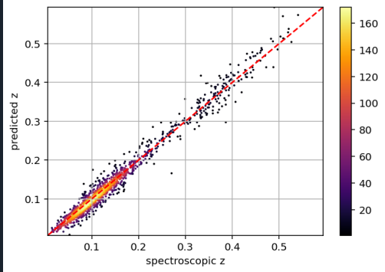
Model Validation of Redshift Predictions
Step Functions
Rendezvous Server
AI for Astronomy
CosmicAI with FMI
Testing at Scale
Key Model Metrics
Predicted vs Spectroscopic redshift values
R² | 0.97
Mean Absolute Error (MAE) | 0.012
Mean Squared Error (MSE) | 0.0003
Key Implications for Model:
Evidence of strong alignment between predicted and actual values; most points cluster along the diagonal red (ideal match) line
These results demonstrate the reliability of our AI inference model for astronomy datasets
This validates that the infrastructure produces scientifically accurate results

Slide 7
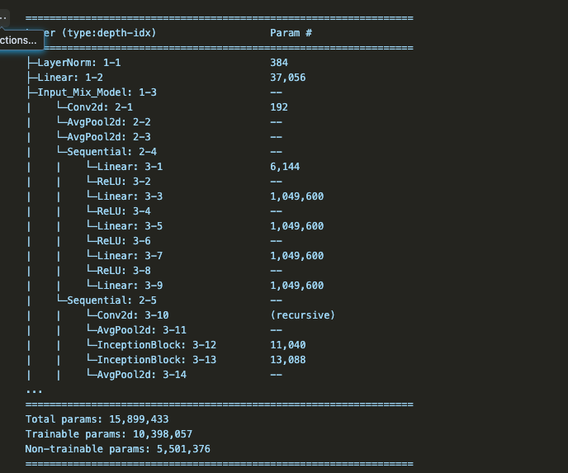
Project Overview and Approach
Step Functions
Rendezvous Server
AI for Astronomy
CosmicAI with FMI
Testing at Scale
Our project aimed to build a scalable AI infrastructure tailored to Redshift Prediction
"Redshift prediction is a fundamental task in astronomy, essential for understanding the expansion of the universe and determining the distances of astronomical objects. Accurate redshift prediction plays a crucial role in advancing our knowledge of the cosmos"
taken from astroMAE see a copy in our github
The fine-tuned Network is ~25 MB and 15 million Parameters
we will explore different systems options
We tested several different deployment options and compared
Several different benchmarks
https://arxiv.org/abs/2409.01825.

Slide 8
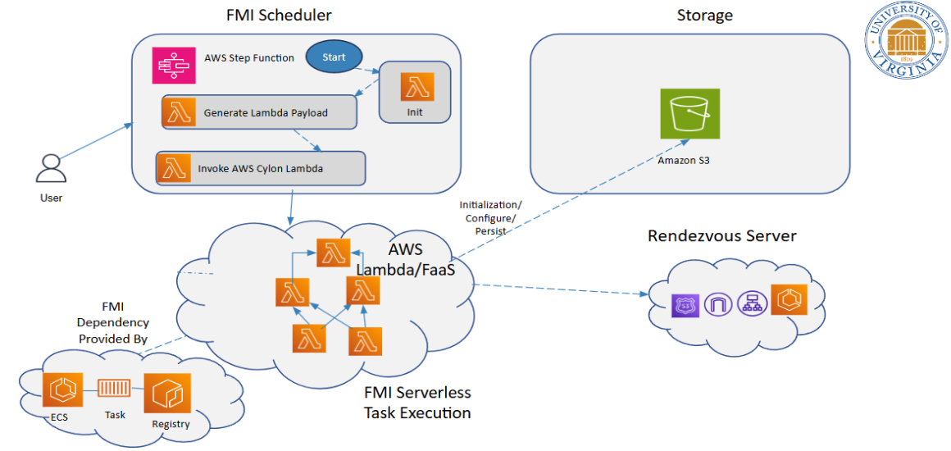
CosmicAI with Lambda FMI Orchestration
Step Functions
Rendezvous Server
AI for Astronomy
CosmicAI with FMI
Testing at Scale
1. Created S3 Bucket (team4-cosmicai)
Created to host scripts and datasets
2. Clone repos
Make sure relevant repository (e.g. Anomaly Detection) is accessible in S3 bucket
3. Edit payload
Updating parameters (e.g. world_size, bucket) in cosmicai state machine in the Lambda Init State
4. Execute Step Function
Monitor workflow in AWS Step Functions, ensuring tasks transition through all states
5. Review Logs and Results
Access CloudWatch logs to analyze execution time and memory usage

Slide 9
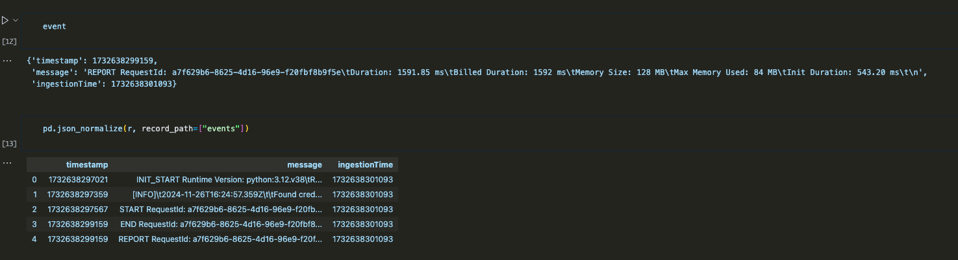
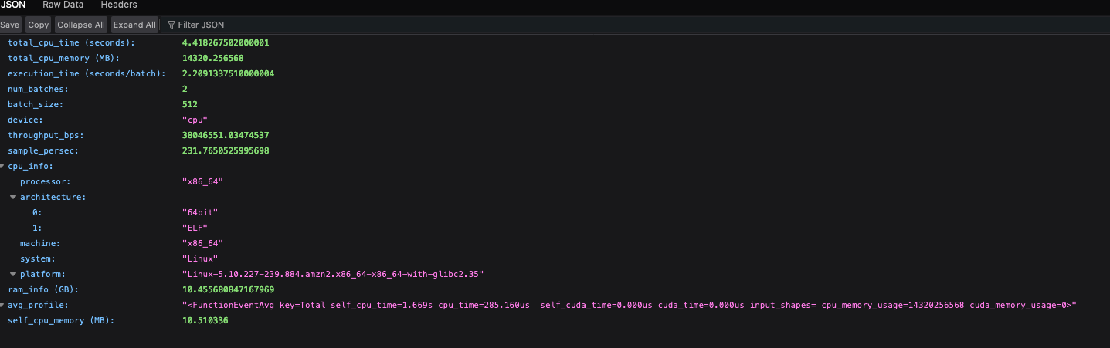
Lambda FMI CloudWatch Logs and JSON Output
Step Functions
Rendezvous Server
AI for Astronomy
CosmicAI with FMI
Testing at Scale

Slide 10
Lambda FMI Performance Summary
Step Functions
Rendezvous Server
AI for Astronomy
CosmicAI with FMI
Testing at Scale
Scenario | Batch Size | World Size | Execution Time (s) | Memory Used (MB) | Throughput (mbps) | Cost Per Batch
Small | 128 | 8 | ~12 | 512 | ~14 | $0.0045
Medium | 256 | 8 | ~18 | 896 | ~18 | $0.0038
Large | 512 | 8 | ~25 | 1024 | ~28 | $0.0023
Parallel (16 lambdas) | 256 | 16 | ~15 | 896 | ~20 | $0.0032
Scaling (12.6 GB dataset) | 512 | 8 | ~35 | 1024 | ~28 | $0.0027

Slide 11
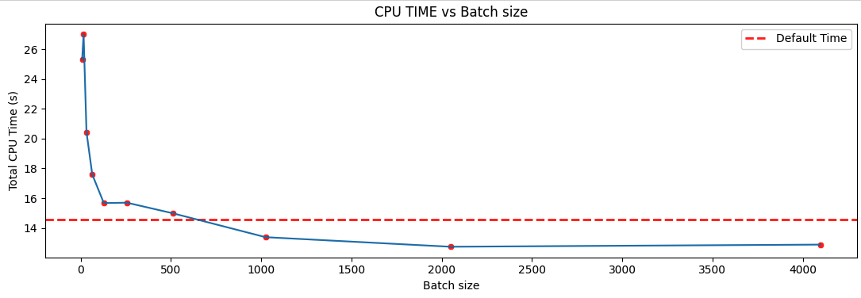
Testing Results
Step Functions
Rendezvous Server
AI for Astronomy
CosmicAI with FMI
Testing at Scale
Local Baseline Testing
Number of Batches | Batch Size
157 | 8
79 | 16
40 | 32
20 | 64
10 | 128
5 | 256
3 | 512
2 | 1024
1 | 2048
1 | 4096
Increasing the Batch Size decreased the total CPU time and total memory used (less passes) but had diminishing returns on effectiveness
The point before diminishing return was either 1024 or 2048, more testing would be needed due to natural variability of runs.
The baseline data was ~64MB

Slide 12
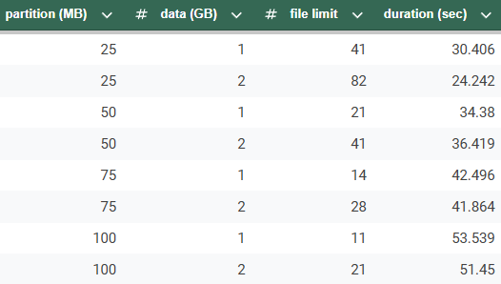
Testing at Scale Experimental Design
Step Functions
Rendezvous Server
AI for Astronomy
CosmicAI with FMI
Testing at Scale

Slide 13
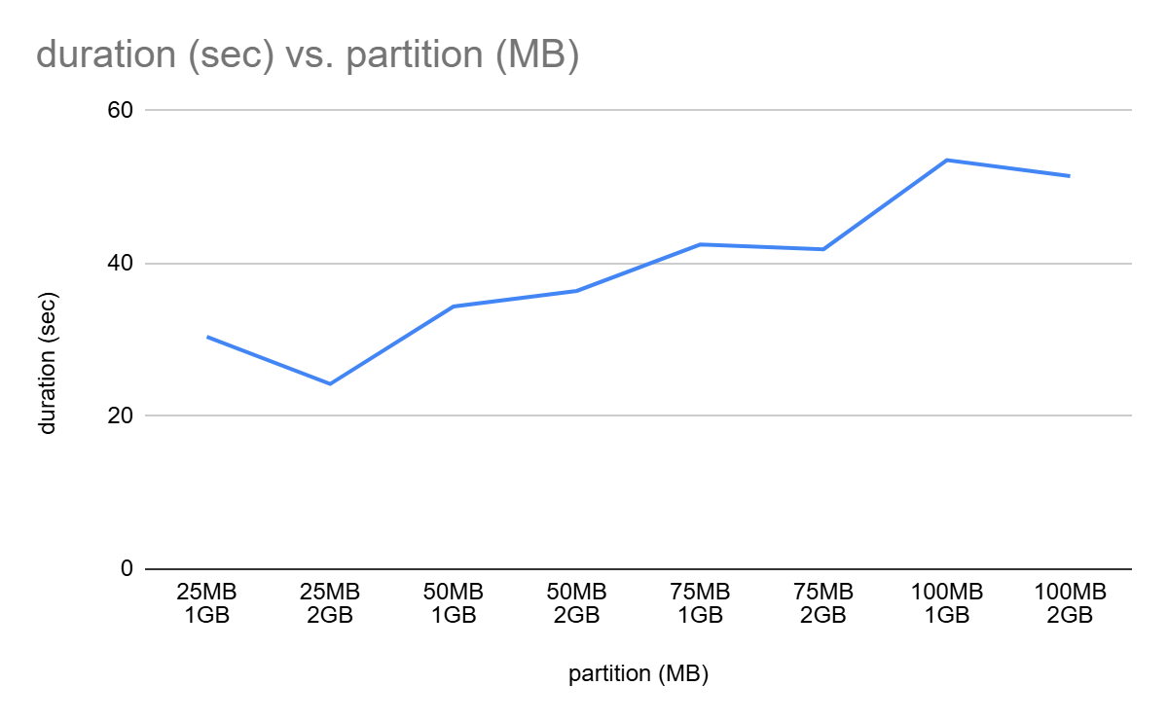
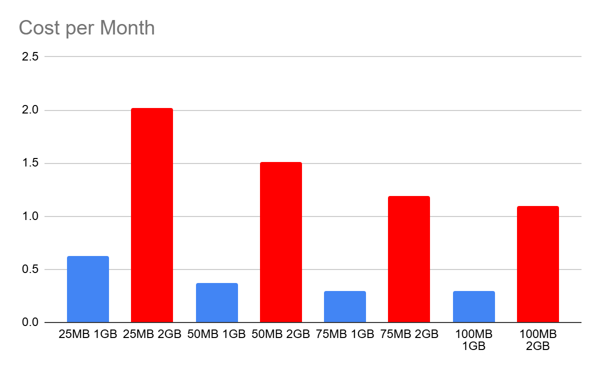
Testing Results
Step Functions
Rendezvous Server
AI for Astronomy
CosmicAI with FMI
Testing at Scale

Slide 14
At each major project milestone, we observed noteworthy conclusions
We observed the following for each core step of the project
The modular design allowed us to seamlessly leverage other AWS services, including most importantly Lambda and S3
The flexibility of the state machine enabled us to experiment with key parameters which proved the scalability of the infrastructure
Communication across Lambda functions allowed us to coordinate parallel tasks across distributed instances
Using FMI, we were able to improve reliability and execution time
Our inferences were highly accurate in predicting redshift values (R² of 0.97, MAE 0.012)
Our AI model for analyzing astronomical data was proven reliable
The system proved to be cost-efficient by scaling work across multiple Lambda instances
Costs decreased as batch sizes increased as a result of reduced overhead
Even with varying batch sizes and dataset sizes, our experiments generally showed consistent scaling performance
Overall, our infrastructure proved scalable and efficient for processing large datasets, validating its applicability for real-world use cases
Step Function
Rendezvous Server
AI for Astronomy
CosmicAI with FMI
Testing at Scale

Slide 15
Appendix
Definitions
AWS Fargate - a serverless compute engine that allows users to run containerized applications without having to manage the underlying infrastructure like servers or clusters
Faas - Functions as a Service, Serverless Computing in response to events
FMI- Faas Message Interface, a library for message passing and collective communication for serverless functions
Serverless Computing - Cloud Computing provider (like AWS) handles the machine compute resources on demand
World Size - Number of Lambda Functions to invoke

